Slide 1
25.
Akutfall Wirbelsäule
Diagnostik/ Manuelle Medizin
Univ.-Prof. Dr. Gerold Ebenbichler

Slide 2
Case 1
45 year old, female, office worker
2 days ago, she woke up in the morning because of acute onset of neck pain, turning her head to the right not possible because of excessive pain
Unable to go to work
Heat pack brought some pain relief, but neck ROM did not improve
Presentation: Ebenbichler
Physical Medicine, Rehabilitation & Occupational Medicine
2
G Ebenbichler
Physical Med, Rehabil & Occupational Med

Slide 3
Case 1 cntnd
Clinical examination:
  Restricted active range of neck motion as follows:
    Flex/Extension 30 - 0 - 10 [normal: 35-45 - 0 - 35-45]
    Lateral flexion: 30 - 0 - 10 [normal: 45 - 0 - 45]
    Rotation: 50 - 0 - 20 [normal: 60-80 - 0 - 60-80]
  No sensory or motor loss in shoulders and upper extremities
Manual medical examination:
  Tender paravertebral neck muscles
  Pain upon palpatory pressure on blocked joint – and upon paravertebral pressure on muscle nodules (~ tip of processus transversus) – no referred pain
  Segmental examination of vertebral joint function:
    restricted rotation to the right and lateroflexion to the right; joint play↓
    → blockage of segment C2/3)
Presentation: Ebenbichler
Physical Medicine, Rehabilitation & Occupational Medicine
3
G Ebenbichler
Physical Med, Rehabil & Occupational Med

Slide 4
Case 1 cntnd
Manual therapeutic interventions:
General and segmental traction
Soft tissue techniques (SCS)
Segmental mobilization with post-isometric relaxation and facilitated by respiratory and eye movement techniques
Manipulation
Thereafter:
hot pack (20 min)
Education in neuromuscular activation and stretching home exercises
Immediately after treatment: unrestricted ROM, no pain, but neck paravertebral muscles still tense
2nd treatment one day later
Remained free from complaints till follow-up 1 week later
Presentation: Ebenbichler
Physical Medicine, Rehabilitation & Occupational Medicine
4
G Ebenbichler
Physical Med, Rehabil & Occupational Med

Slide 5
Diagnostics/ Manual Medicine
Gerold Ebenbichler MD
Department of Physical Medicine, Rehabilitation & Occupational Medicine
Medical University of Vienna, General Hospital of Vienna
Presentation: Ebenbichler
Physical Medicine, Rehabilitation & Occupational Medicine
G Ebenbichler
Physical Med, Rehabil & Occupational Med

Slide 6
Reasons for Medical Consultation
Musculoskeletal System
  Pain
  Weakness
  Restricted Range of Motion
  Structural alterations
  Instability
  Loss of sensibility
In industrialized countries musculoskeletal impairments are most frequent reason for a pain related disorder; of these ~2/3 account for pain related spine disorders
Only ~15% of pain related complaints relate to a morphological impairment (e.g. disc herniation, spinal stenosis, fracture, inflammation etc)
Presentation: Ebenbichler
Physical Medicine, Rehabilitation & Occupational Medicine
6
G Ebenbichler
Physical Med, Rehabil & Occupational Med

Slide 7
Manual Medicine
Manual Medicine is the medical discipline of enhanced knowledge and skills, that by the use of theoretic basis, knowledge and conventional medical techniques of further medical specialties, carries out on one hand the manual diagnostic examination of the locomotor system, the head, visceral attachments and connective tissue structures; on the other hand, it adds manual techniques to the treatment of functional reversible disorders aiming to prevention, cure and rehabilitation of the latter.
Diagnostic and therapeutic procedures are based on scientific neurophysiological and biomechanical principles. Manual Medicine is a cross-sectional postgraduate apprenticeship and can be carried out by all medical specialists. Within the framework of a multimodal therapeutic concept, Manual Medicine encompasses the interdisciplinary application of its diagnostic and therapeutic techniques for the diagnosis and treatment of reversible dysfunctions of the locomotor system and the resulting ailments. Additionally, systemic chain-reactions – vertebrovisceral, viscerovertebral and viscerocutaneous – within the locomotor system as well as psychosomatic influences are also adequately considered (“chain” means interlinked functional symptoms in the locomotor system).
Presentation: Ebenbichler
Physical Medicine, Rehabilitation & Occupational Medicine
7
ESSOMM 2023
G Ebenbichler
Physical Med, Rehabil & Occupational Med

Slide 8
Diagnosis in Manual Medicine
Diagnostic skills in manual medicine build upon conventional medical techniques with manual examination of individual tissues and functional assessment of the whole locomotor system based upon scientific biomechanical and neurophysiologic principles.
Presentation: Ebenbichler
8
Adapted from ESSOMM 2022
Physical Medicine, Rehabilitation & Occupational Medicine
G Ebenbichler
Physical Med, Rehabil & Occupational Med

Slide 9
MM Diagnostics
Identifies and differentiates:
  Reversible impairments primary domain
  Irreversible impairments adjunct
Examines:
  Skin
  Muscle/ connective tissues/ tendons
  Ligaments
  Joints and bones
→→ Understand the complexity of structural and functional changes of the musculoskeletal problem
Presentation: Ebenbichler
Physical Medicine, Rehabilitation & Occupational Medicine
9
G Ebenbichler
Physical Med, Rehabil & Occupational Med

Slide 10
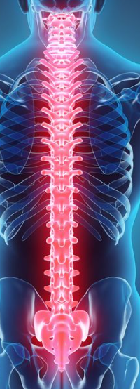
joint
ligaments
muscles
muscles
joint capsle
connective
tissues
tendons
autonomous
nervous system
lymphatic
system
vessels
hormones
sensory organs
CNS
PNS
psyche
Presentation: Ebenbichler
Physical Medicine, Rehabilitation & Occupational Medicine
10
„Segemental reflectory complex“, schematic presentation (adopted from Tilscher & Eder 2008)
G Ebenbichler
Physical Med, Rehabil & Occupational Med
Picture: https://www.pinterest.com/pin/648588783809904022/

Slide 11
Diagnostic work-up
Presentation: Ebenbichler
Physical Medicine, Rehabilitation & Occupational Medicine
11
G Ebenbichler
Physical Med, Rehabil & Occupational Med

Slide 12
Structure Analysis from clinical and morphological findings
Clinical
Morphology
Findings from:
Patients history
Inspection
Palpation of structures
„Pain“ palpation
Stress tests (provocation)
Examination of function (testing of function)
Imaging studies, laboratory testing
Treatment (trial)
Re-assessment
Presentation: Ebenbichler
Physical Medicine, Rehabilitation & Occupational Medicine
12
Adapted from Tilscher H Man Med 2017: 55: 18
G Ebenbichler
Physical Med, Rehabil & Occupational Med

Slide 13
MM Diagnostic work up
Patient history
  Where and how did complaints start?
  Worsening of complaints with certain activities or postures?
  Duration (acuity)
  Age, gender, profession?
  Family history?
  Trauma?
  Sports?
  Previous episodes?
  Treatments in the past?
Presentation: Ebenbichler
Physical Medicine, Rehabilitation & Occupational Medicine
13
G Ebenbichler
Physical Med, Rehabil & Occupational Med

Slide 14
Organpathologie
Gleichzeitige medizinische Probleme
______________________
Iatrogene Faktoren
Überzeugungen
Coping Strategien
Distress
Krankheitsverhalten
Bereitschaft zur Veränderung
_______________________
Familie als Verstärker
Arbeitsbedingungen
Rechtsstreitigkeiten
________________________
Arbeitszufriedenheit
Arbeitsbedingungen
Arbeitsinhalte
Soziale Richtlinien
Biomedizinische
Probleme
Tumore
Entzündung
Fraktur
Neurologische Strng
Psychologische und
Verhaltensbedingte
Faktoren
Faktoren, die das Risiko für Chronifizierung und Behinderung födern
Soziale und
ökonomische Faktoren
Monotone Arbeit
Geringe Kntrl über Arbeit
Geringe Unterstützung
Arbeitsplatzbezogene
Faktoren
Organisations ass. Aspekte inkl Frühpensionsbegehren,
Sick days
Klinische Red flags
Klinische Yellow flags
Arbeitsbezogene Blue flags
Sozio-arbeitsbezogne Black flags
Presentation: Ebenbichler
Physical Medicine, Rehabilitation & Occupational Medicine
14
G Ebenbichler
Physical Med, Rehabil & Occupational Med

Slide 15
MM Diagnostic work up
Inspection
  Dynamic impression
  Postural and static abnormalities
  Structural abnormalities scoliosis, kyphosis, vertebral step
  Skin
  Supportive aids? - Crutches, cane
  …
Presentation: Ebenbichler
Physical Medicine, Rehabilitation & Occupational Medicine
15
G Ebenbichler
Physical Med, Rehabil & Occupational Med

Slide 16
MM Diagnostic work up
Palpation
Vertebral and segmental findings on palpation
  Structural abnormalities (skin tissue texture, connective tissue, muscle, bone)
  Tenderness of soft tissues (i.e. compliance [compression and elasticity])
  ROM and end feeling of the joint/ segment ROM
Pain on palpation (skin, connective tissues, muscle, joint/bone)
Presentation: Ebenbichler
Physical Medicine, Rehabilitation & Occupational Medicine
16
G Ebenbichler
Physical Med, Rehabil & Occupational Med

Slide 17
MM Diagnostic work up
Testing of Function
  Global ROM (active and passive)
      anteflexion, retroflexion, rotation in cervical, thoracic and lumbar spine
        harmony of movement (avoiding)
        harmonic curvature/ vertebral plateau
      Schober Index, Finger-floor distance, Odd Index
  Segmental ROM, end-ROM feeling
  Segmental joint stability/ elasticity
  Tissue texture - abnormalities (e.g. Kibler skin fold, connective tissue stroke)
  Palpatory testing of muscle tone (tenderness of muscles and connective tissues (spasm, muscle hypertonus))
  Pain-palpatory testing (tender and trigger points, sensitized ligaments and joints and bones)
  Muscle length testing
  Muscle strength/ neuromuscular activation – neurologic deficits
  Sensory testing
  Neuromuscular coordination
Presentation: Ebenbichler
Physical Medicine, Rehabilitation & Occupational Medicine
17
G Ebenbichler
Physical Med, Rehabil & Occupational Med

Slide 18
MM Diagnostic work up
Testing of Joint Function
Segmental joint function
  Restricted movement direction
  End feeling of segmental motion (elasticity)
  Joint play and joint elasticity (diagnosis of segmental joint blockage)
  Instability tests (C1/C2)
Presentation: Ebenbichler
Physical Medicine, Rehabilitation & Occupational Medicine
18
G Ebenbichler
Physical Med, Rehabil & Occupational Med

Slide 19
Types of functional impairments
Joint/ segment
M99.1 (biomechanical lesions of the vert column)
Muscle, con. tissue
M79.1 (Myofascial pain syndrome)
M 72.9 (Fasciitis)
Coordination
Blockage
Hypermobility, Instability
Stiffness (hypertonic)
Shortened
Weakened
Static stereotype
Dynamic stereotype
Presentation: Ebenbichler
Physical Medicine, Rehabilitation & Occupational Medicine
19
G Ebenbichler
Physical Med, Rehabil & Occupational Med

Slide 20
MM Diagnostic work up
Laboratory tests and Imaging studies
Rule out major pathologies!
  Inflammatory diseases (e.g. spondylarthitis, spondylodiscitis,, M Bechterew, ..)
  Trauma (e.g. vertebral fracture,.. )
  Malignancies (e.g. multiple myeloma, metastasis,..)
  Neurological pathologies (e.g. weakness, urinary &/or bowel cntrl,…)
  Musculoskeletal morphological pathologies:
    (e.g. spinal stenosis, disc herniation, listhesis, …)
  Internal organs (viscerovertebral), skin (herpes zoster)
  Diagnose reversible structural and functional impairments of the musculoskeletal system
Presentation: Ebenbichler
Physical Medicine, Rehabilitation & Occupational Medicine
20
G Ebenbichler
Physical Med, Rehabil & Occupational Med

Slide 21
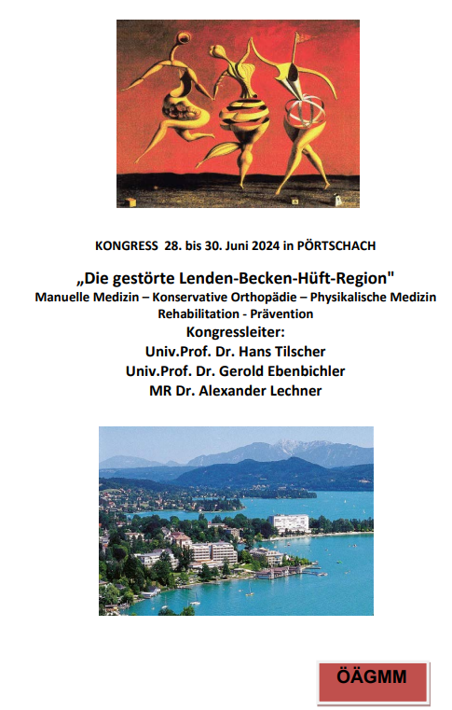

Slide 22
Manuelle Medizin
Manuelle Medizin ist die medizinische Disziplin, in der unter Nutzung der theoretischen Grundlagen, Kenntnisse und Verfahren aller medizinischer Gebiete die Befundaufnahme am Bewegungssystem – dazu gehören alle Strukturen, die in neuroreflektorisch-humoraler Wechselwirkung zum Bewegungsorgan stehen, sowie die Behandlung ihrer Funktionsstörungen mit der Hand unter präventiver, kurativer und rehabilitativer Zielsetzung erfolgt. Diagnostik und Therapie beruhen auf biomechanischen und neurophysiologischen Prinzipien. Sie umfasst im Rahmen eines multimodalen Therapiekonzeptes die interdisziplinäre Anwendung ihrer diagnostischen und therapeutischen Techniken zur Erkennung und Behandlung gestörter Funktionen des Bewegungssystems und der davon ausgehenden Beschwerden. Dabei finden auch Verkettungen von Funktionsstörungen innerhalb des Bewegungssystems, vertebroviszeral, viszerovertebral und viszerokutan sowie psychosomatische Einflüsse ihre angemessene Berücksichtigung.
Manuelle Medizin ist eine dem Menschen zugewandte Medizin mit ganzheitlicher Betrachtungsweise. Sie bezeichnet ein diagnostisches System und therapeutische Techniken, die mit den Händen ausgeführt werden. Sie umfasst auch osteopathische Techniken an verschiedenen Abschnitten des Bewegungssystems, dem Lymphsystem und den bindegewebigen Aufhängungen und Faszien innerer Organe.
Manuelle Medizin ist die medizinische Disziplin, die sich umfassend mit Diagnose, Therapie und Prävention reversibler Funktionsstörungen am Bewegungsorgan und anderen damit verbundenen Organsystemen befasst. Neuroanatomische und -physiologische Grundelemente sind die Grundlage der Wirkungsweisen manualmedizinischer Diagnostik und Therapie.
Presentation: Ebenbichler
Physical Medicine, Rehabilitation & Occupational Medicine
22
ESSOMM 2023
G Ebenbichler
Physical Med, Rehabil & Occupational Med

